Slide 1
Computer Networks
BCSE308L

Slide 2
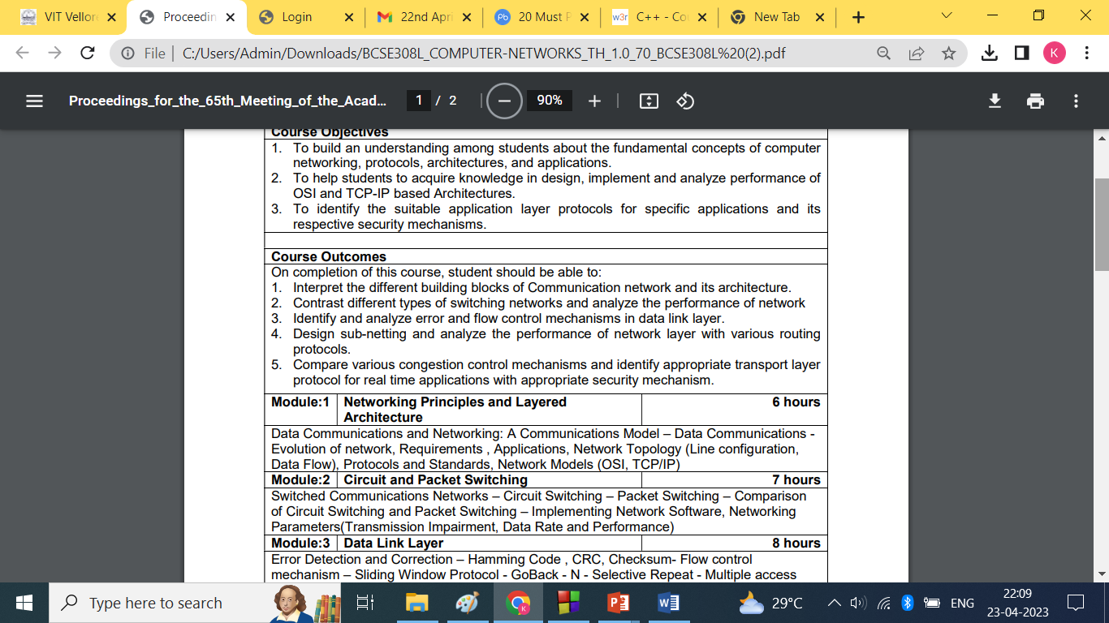
COURSE OUTCOMES

Slide 3
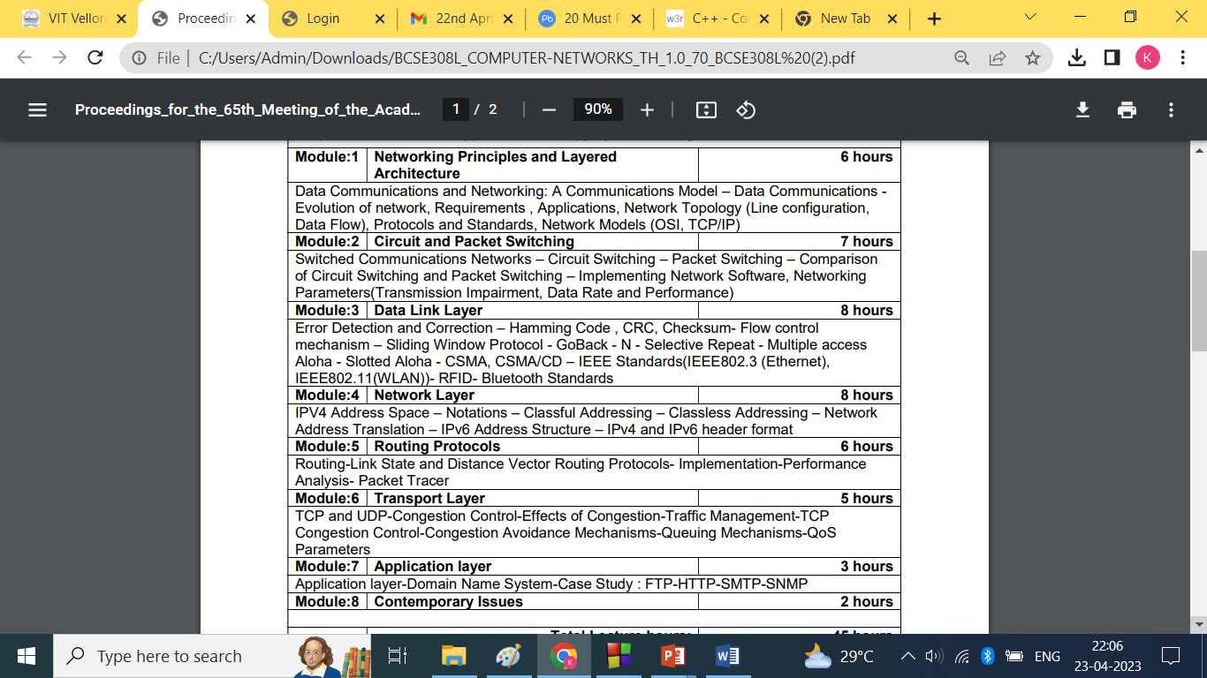

Slide 4
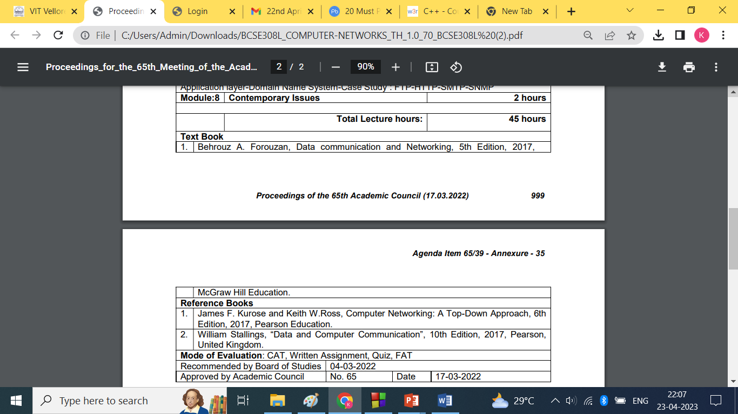

Slide 5
COMMUNICATION- wired, wireless
DATA COMMUNICATION-
end nodes- PC, printer
Intermediate nodes- Switch, internet Cloud, router
NETWORK- resource sharing
ARCHITECTURE

Slide 6
Data communication
The term telecommunication means communication at a distance.
The word data refers to information presented in whatever form is agreed upon by the parties creating and using the data.
Data communications are the exchange of data between two devices via some form of transmission medium such as a wire cable.

Slide 7
Data communication characteristics
Delivery
Accuracy
Timeliness
Jitter

Slide 8
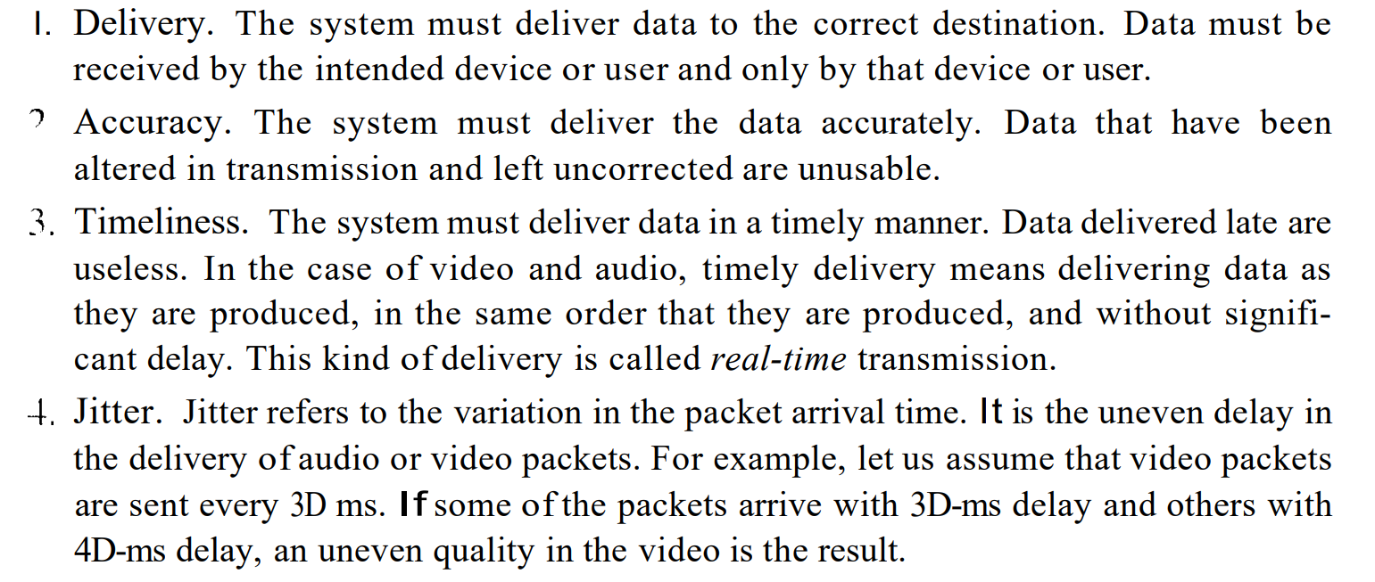
Data communication characteristics

Slide 9
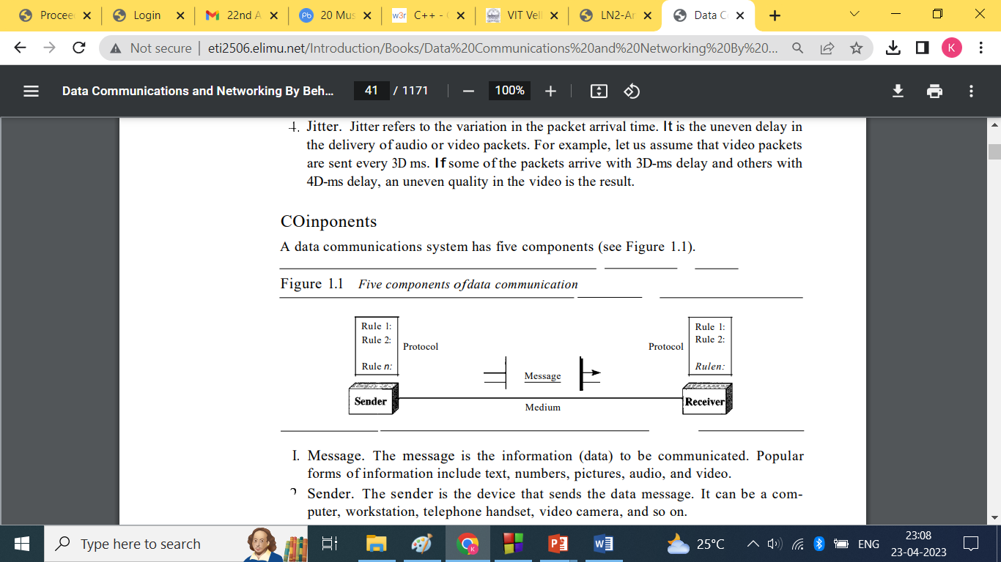

Slide 10
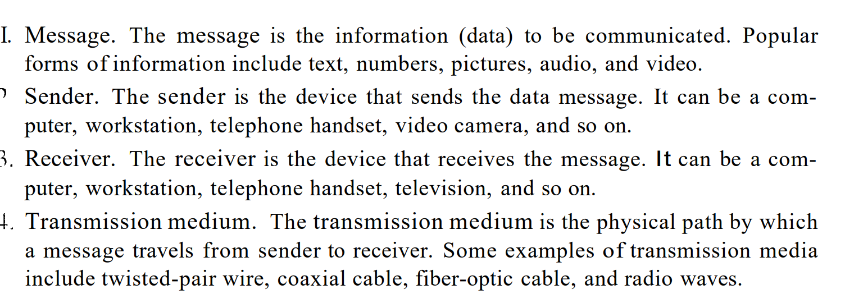
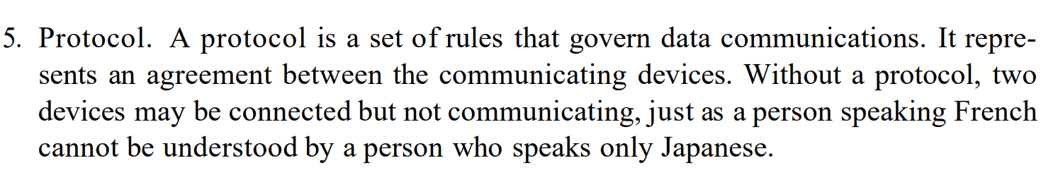
Components

Slide 11
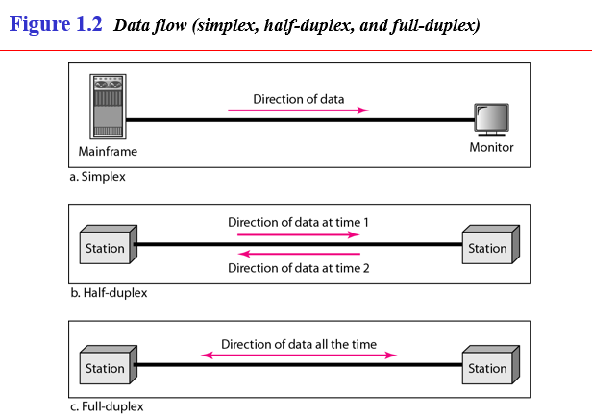

Slide 12
Network
A network is a set of devices (often referred to as nodes) connected by communication links.
A node can be a computer, printer, or any other device capable of sending and/or receiving data generated by other nodes on the network.

Slide 13
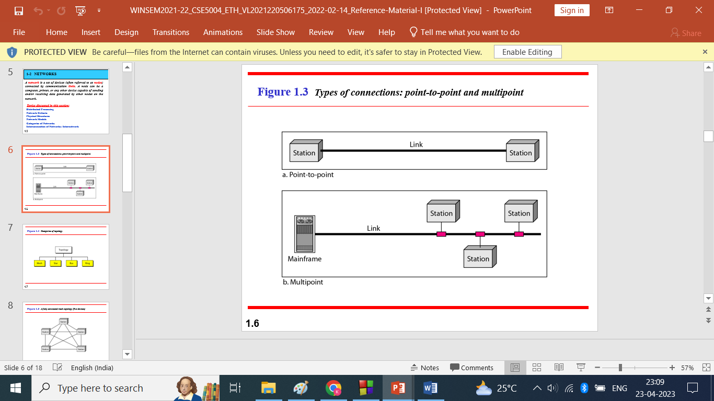
Point to Point:
Between two devices.
Entire capacity is reserved between two devices
Multi Point:
Broadcast connection
Two or more share a single link
Capacity is shared
Spatial( link shared simultaneously)
Temporal(shared on turn basis)

Slide 14
Networking Protocols
Message encoded(Signal conversion)
Message transmitted(Channel)
Message received(unicast, multicast, broadcast)
Peer- Peer network(one to one)
Client- Server network(server to client)

Slide 15
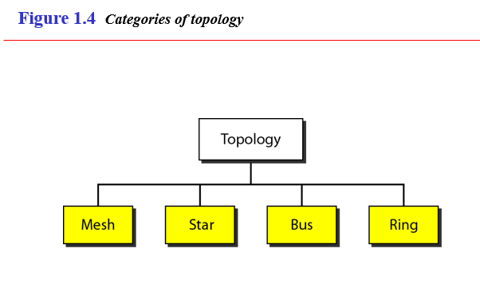

Slide 16
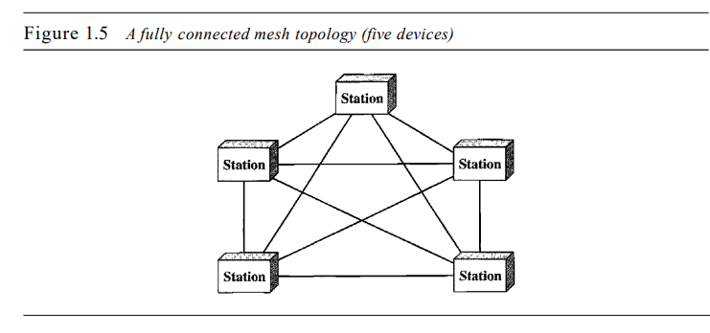
Mesh Topology

Slide 17
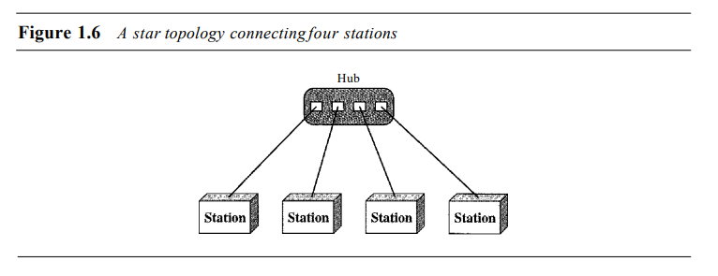
Star topology

Slide 18
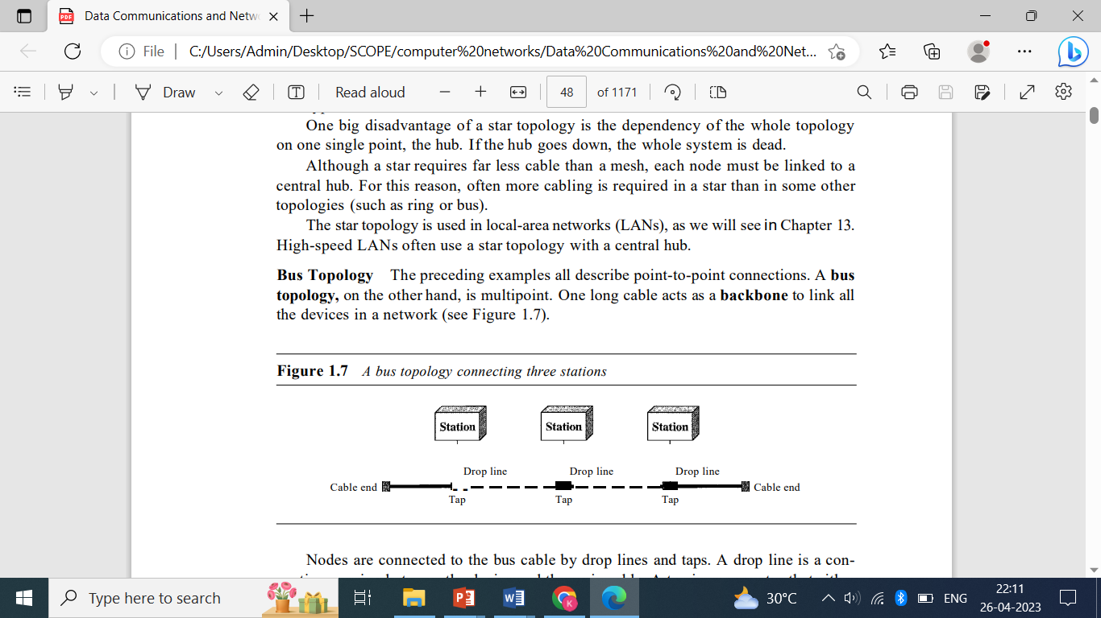
Bus topology

Slide 19
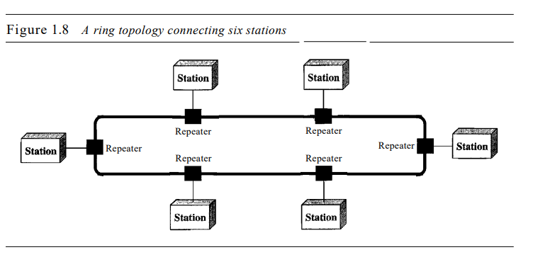
Ring topology

Slide 20
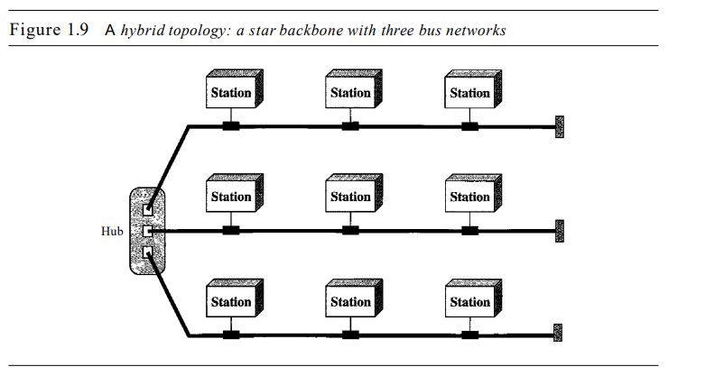
Hybrid Topology

Slide 21
Components of computer network
Nodes(End nodes-computers, printers, cameras. Intermediate node-Switches, Hub, Routers)
Media(Medium of transmission-Wired, Wireless)
Services(Gaming,e-mail, google drive(storage), file sharing, instant communication, World wide web)

Slide 22
Wired medium
Ethernet Straight through cable-(Connection btw two different nodes)
Ethernet crossover cable-(connections between same kind of nodes)
FOC(Fiber Optic cable)
Coaxial Cable
USB cable

Slide 23
Wireless medium
Infra red(Tv remote)
Radio waves( Bluetooth, WiFi)
Microwaves (Cellullar Systems)
Satellite (GPS)

Slide 24
Classification of computer networks
Local Area Network(LAN)-(limited area)
Wired LAN(Ethernet-Hub, Switch)
Wireless LAN(Wi-Fi)
Metropolitan Area Network(MAN)(connects network geographically in small range, btw two LAN)
Wide Area Network(WAN)- connects wide goegraphical area-telecommunication network
Internet (wide WAN)

Slide 25
IPv4, IPv6, MAC
IP address(ipconfig)
Location based
4 octets(32 bits- decimal)
0.0.0.0 to 255.255.255.255
Manual or dynamic
MAC ADDRESS(ipconfig/all)
Name of the device
Physical address
Not on locality
UNIQUE
48 bits(- . :) hexadecimal

Slide 26
Port address port number
Identify the process(resmon-resource monitoring)
Communicate the end point
Assigned by OS
0-65535

